Slide 1
Analysis and Recommendations for Road Safety Improvement

Slide 2
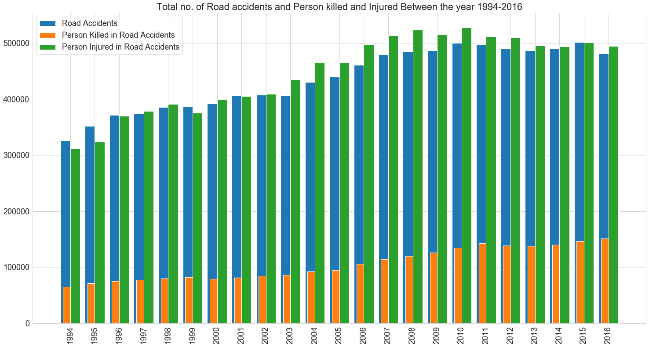
Road Accident Analysis Between the year 1994-2016

Slide 3
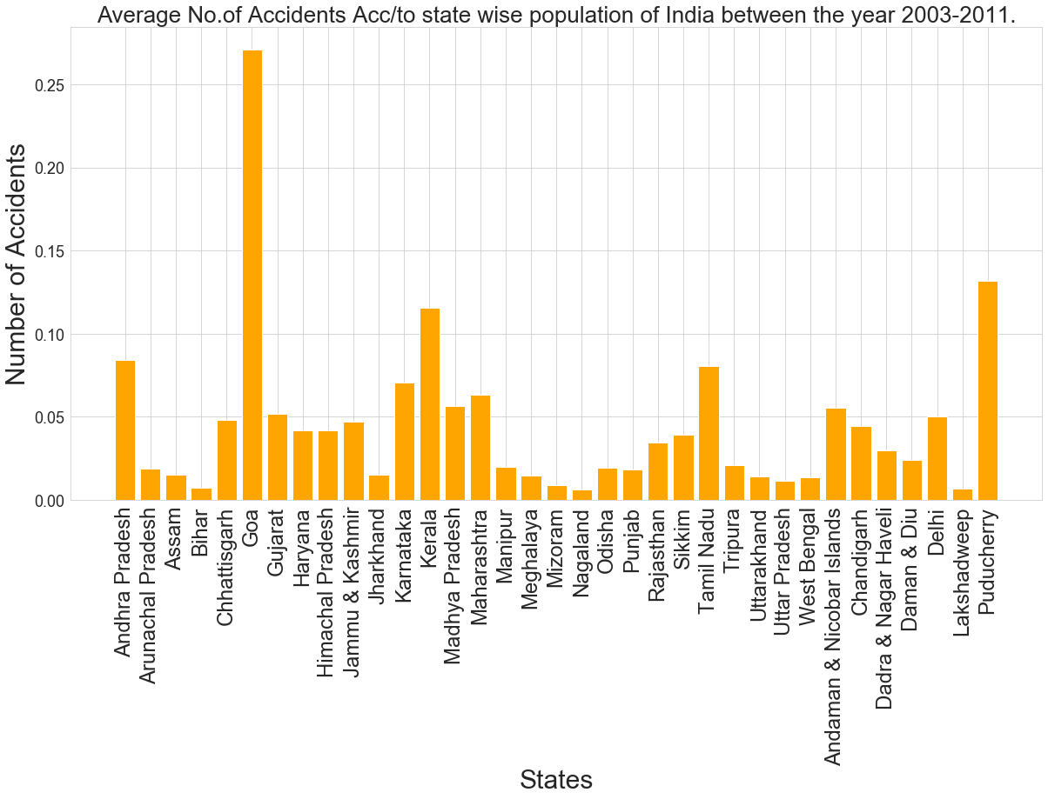
States/UTs wise Road Accidents Analysis

Slide 4
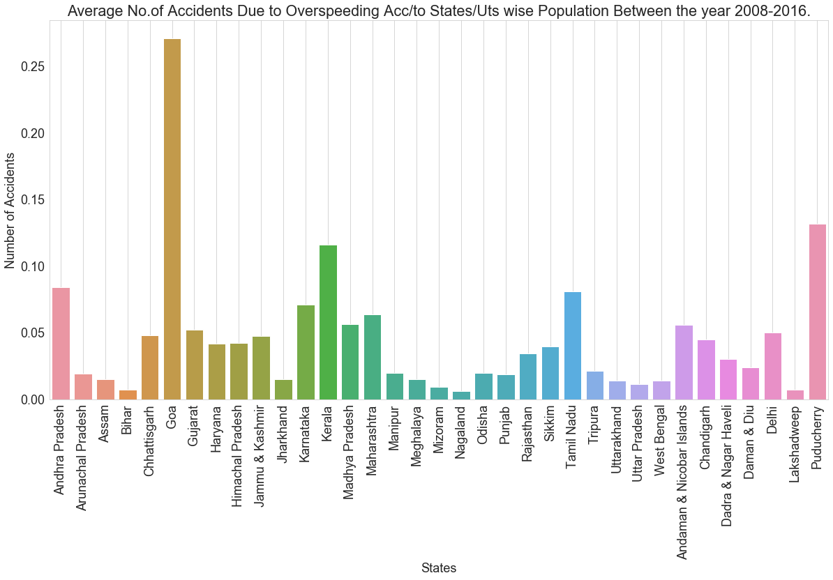
Accidents Due to OverSpeeding

Slide 5
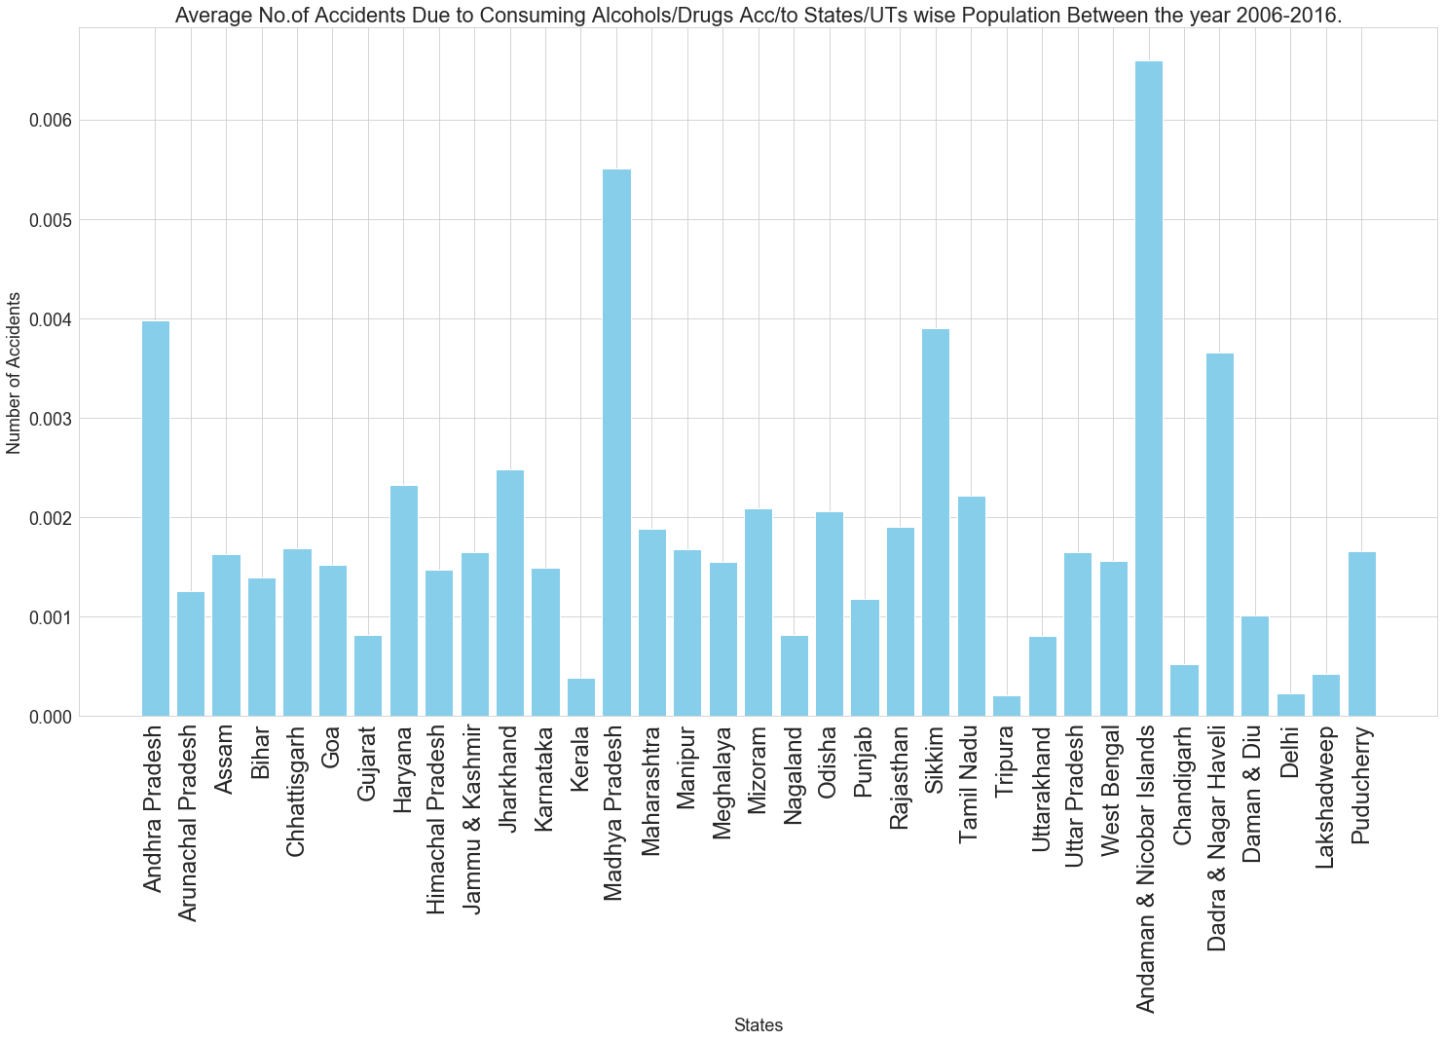
Accidents Due to Consuming Alcohols/Drugs

Slide 6
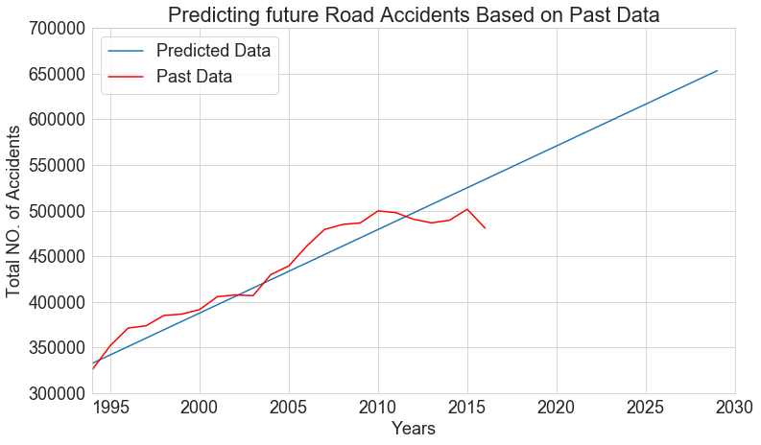

Linear Regression Model to Predict Future Road Accidents

Slide 7
Suggestions To Reduce Road Accidents
Install Over speeding cameras on the Roads.
Implement speed controller Device.
Alcohol Detector Sensor
Notes:
which aims to keep vehicle speed in check and reduce accidents.

